Slide 1
Incentivizing Good Governance and Financial Administration
March 16, 2023
Atty. Odilon L. Pasaraba, CESO III
Assistant Secretary for Local Government
Department of the Interior and Local Government

Slide 2
POLITICS
Managing our power
ECONOMICS
Managing our resources
GOVERNANCE
Enabling development
Notes:
A government is made functional by interconnectedness. Our institutions thrive when they work together, complementing and supplementing each other. Traditionally, we see the role of the national government as one which provides command and supervision over our LGUs. But we can reimagine this function – certainly by drawing from the lessons of the COVID-19 pandemic.
1.From assisting the national government, LGUs stepped up and took the lead in service delivery and ensuring the welfare of their constituents. Because of the urgent nature of the pandemic and the swift response it demands, our LGUs provided coordinated action at the local level starting on day 1.
2.The pandemic also caused us to take into greater consideration the inputs of our local government units, especially as regards COVID-19 community quarantine protocols. We successfully maintained the balance of having a unified approach AND giving our local leaders enough flexibility to make decisions based on data and context-based needs and realities.
3.Finally, the pandemic brought to the fore the need for additional resources of many LGUs, and this also led to other LGUs picking up the mantle and providing them assistance. We have seen inter-LGU cooperation like never before. Some LGUs help in their neighbor’s vaccination drives, others coordinate regarding their respective contact tracing initiatives.
These are important, positive developments on the role of local government units, which we should capitalize on and continue to improve, so as to ensure a responsive and efficient LG sector.

Slide 3

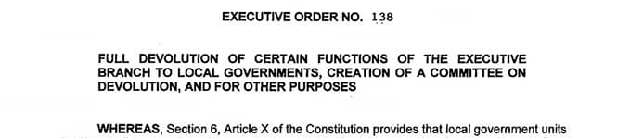
PRIMARY CHALLENGE IN LOCAL FINANCIAL MANAGEMENT TODAY
Managing limited resources…
…to provide for expanding
and growing demand for
local services.
Notes:
A government is made functional by interconnectedness. Our institutions thrive when they work together, complementing and supplementing each other. Traditionally, we see the role of the national government as one which provides command and supervision over our LGUs. But we can reimagine this function – certainly by drawing from the lessons of the COVID-19 pandemic.
1.From assisting the national government, LGUs stepped up and took the lead in service delivery and ensuring the welfare of their constituents. Because of the urgent nature of the pandemic and the swift response it demands, our LGUs provided coordinated action at the local level starting on day 1.
2.The pandemic also caused us to take into greater consideration the inputs of our local government units, especially as regards COVID-19 community quarantine protocols. We successfully maintained the balance of having a unified approach AND giving our local leaders enough flexibility to make decisions based on data and context-based needs and realities.
3.Finally, the pandemic brought to the fore the need for additional resources of many LGUs, and this also led to other LGUs picking up the mantle and providing them assistance. We have seen inter-LGU cooperation like never before. Some LGUs help in their neighbor’s vaccination drives, others coordinate regarding their respective contact tracing initiatives.
These are important, positive developments on the role of local government units, which we should capitalize on and continue to improve, so as to ensure a responsive and efficient LG sector.

Slide 4
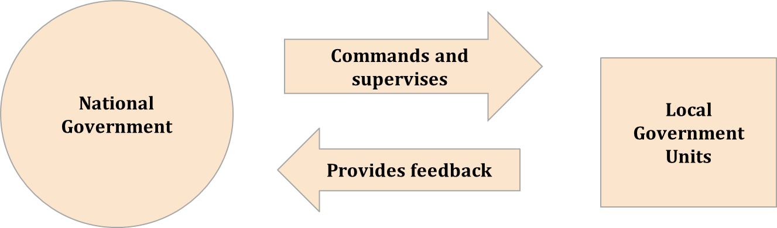
THE FUNCTIONAL GOVERNMENT
Paradigm shift in the LGU’s role
Assisting the national government
Implementing national laws & regulations
Ambivalence & competition among LGUs
Taking the lead in service delivery
LGU-driven policies and protocols
“Big brother” mentality
Notes:
A government is made functional by interconnectedness. Our institutions thrive when they work together, complementing and supplementing each other. Traditionally, we see the role of the national government as one which provides command and supervision over our LGUs. But we can reimagine this function – certainly by drawing from the lessons of the COVID-19 pandemic.
1.From assisting the national government, LGUs stepped up and took the lead in service delivery and ensuring the welfare of their constituents. Because of the urgent nature of the pandemic and the swift response it demands, our LGUs provided coordinated action at the local level starting on day 1.
2.The pandemic also caused us to take into greater consideration the inputs of our local government units, especially as regards COVID-19 community quarantine protocols. We successfully maintained the balance of having a unified approach AND giving our local leaders enough flexibility to make decisions based on data and context-based needs and realities.
3.Finally, the pandemic brought to the fore the need for additional resources of many LGUs, and this also led to other LGUs picking up the mantle and providing them assistance. We have seen inter-LGU cooperation like never before. Some LGUs help in their neighbor’s vaccination drives, others coordinate regarding their respective contact tracing initiatives.
These are important, positive developments on the role of local government units, which we should capitalize on and continue to improve, so as to ensure a responsive and efficient LG sector.

Slide 5
BASIC OBLIGATIONS OF LGUs UNDER THE LG CODE
General supervision over LGU programs and projects
Delivery of basic services and facilities to constituents
Sections 17 and 455(b)(4)
Section 455(b)(1)
Enactment and enforcement of ordinances
Generation of resources and sources of revenue
Section 455(b)(2)
Section 455(b)(3)
Notes:
Basic obligations under the LG Code are:
Exercise general supervision and control over all programs, projects, services, and activities of the city government
Enforce all laws and ordinances relative to the governance of the city and implement programs and activities in the exercise of corporate powers
Generate resources and revenues and apply the same to the implementation of development plans, programs, and priorities
Ensure the delivery of basic services and the provision of adequate facilities to constituents.

Slide 6
INTER-LGU FUNCTIONS AND RELATIONS
Empowers and supervises component cities and municipalities (dynamic mechanism for developmental processes and effective governance)
PROVINCE
CITY / MUNICIPALITY
Fulfills the primary responsibility of enforcing laws and ordinances, implementing local programs, and providing basic service delivery
BARANGAY
Primary planning and implementing unit and acts as first responders to the needs of the community
Notes:
But these basic functions should also be seen in light of the LGU’s functions and relations with respect to each other.
Provincial governments, for example, are mandated to empower and supervise component cities and municipalities. The province, composed of cluster of municipalities, or municipalities and component cities, and as a political and corporate unit of government, serves as dynamic mechanism for developmental processes and effective governance of local government units within its territorial jurisdiction.
Cities and municipalities, on the other hand, fulfill the primary responsibilities of enforcing laws and ordinances, implementing local programs, and providing basic service delivery. The city and municipality, consisting of a group of barangays, serves primarily as a general purpose government for the coordination and delivery of basic, regular and direct services and effective governance of the inhabitants within its territorial jurisdiction.
Finally, they do this with the help of the barangay, which act as first responders to the needs of the community. As the basic political unit, the barangay serves as the primary planning and implementing unit of government policies, plans, programs, projects, and activities in the community, and as a forum wherein the collective views of the people may be expressed, crystallized and considered, and where disputes may be amicably settled.

Slide 7
SGLG CRITERION: GOOD FISCAL OR FINANCIAL ADMINISTRATION
This criterion refers to the condition where an LGU demonstrates positive and stable economic performance, and maintains, preserves and mandatorily upholds the practices of:
Fiscal discipline
Sustainability
Accountability and transparency
by adhering to pertinent budgeting laws, rules, and best practices in public financial management
The covered indicators are as follows:
Issuance of an unqualified or qualified COA opinion in the immediately preceding year
FDP compliance for local budget and bids
Local revenue collection growth
Utilization of 20% component of the IRA for local development projects
Notes:
But these basic functions should also be seen in light of the LGU’s functions and relations with respect to each other.
Provincial governments, for example, are mandated to empower and supervise component cities and municipalities. The province, composed of cluster of municipalities, or municipalities and component cities, and as a political and corporate unit of government, serves as dynamic mechanism for developmental processes and effective governance of local government units within its territorial jurisdiction.
Cities and municipalities, on the other hand, fulfill the primary responsibilities of enforcing laws and ordinances, implementing local programs, and providing basic service delivery. The city and municipality, consisting of a group of barangays, serves primarily as a general purpose government for the coordination and delivery of basic, regular and direct services and effective governance of the inhabitants within its territorial jurisdiction.
Finally, they do this with the help of the barangay, which act as first responders to the needs of the community. As the basic political unit, the barangay serves as the primary planning and implementing unit of government policies, plans, programs, projects, and activities in the community, and as a forum wherein the collective views of the people may be expressed, crystallized and considered, and where disputes may be amicably settled.

Slide 8
SNAPSHOT OF LOCAL FINANCIAL ADMINISTRATION IN NORTH LUZON
45 out of 142
10 out of 73
22 out of 114
12 out of 17
Source: SGLG Consolidated GAR CY 2019
Notes:
But these basic functions should also be seen in light of the LGU’s functions and relations with respect to each other.
Provincial governments, for example, are mandated to empower and supervise component cities and municipalities. The province, composed of cluster of municipalities, or municipalities and component cities, and as a political and corporate unit of government, serves as dynamic mechanism for developmental processes and effective governance of local government units within its territorial jurisdiction.
Cities and municipalities, on the other hand, fulfill the primary responsibilities of enforcing laws and ordinances, implementing local programs, and providing basic service delivery. The city and municipality, consisting of a group of barangays, serves primarily as a general purpose government for the coordination and delivery of basic, regular and direct services and effective governance of the inhabitants within its territorial jurisdiction.
Finally, they do this with the help of the barangay, which act as first responders to the needs of the community. As the basic political unit, the barangay serves as the primary planning and implementing unit of government policies, plans, programs, projects, and activities in the community, and as a forum wherein the collective views of the people may be expressed, crystallized and considered, and where disputes may be amicably settled.

Slide 9
SNAPSHOT OF LOCAL FINANCIAL ADMINISTRATION IN NORTH LUZON
Source: SGLG Consolidated GAR CY 2019
Notes:
But these basic functions should also be seen in light of the LGU’s functions and relations with respect to each other.
Provincial governments, for example, are mandated to empower and supervise component cities and municipalities. The province, composed of cluster of municipalities, or municipalities and component cities, and as a political and corporate unit of government, serves as dynamic mechanism for developmental processes and effective governance of local government units within its territorial jurisdiction.
Cities and municipalities, on the other hand, fulfill the primary responsibilities of enforcing laws and ordinances, implementing local programs, and providing basic service delivery. The city and municipality, consisting of a group of barangays, serves primarily as a general purpose government for the coordination and delivery of basic, regular and direct services and effective governance of the inhabitants within its territorial jurisdiction.
Finally, they do this with the help of the barangay, which act as first responders to the needs of the community. As the basic political unit, the barangay serves as the primary planning and implementing unit of government policies, plans, programs, projects, and activities in the community, and as a forum wherein the collective views of the people may be expressed, crystallized and considered, and where disputes may be amicably settled.

Slide 10
SNAPSHOT OF LOCAL FINANCIAL ADMINISTRATION IN NORTH LUZON
Source: SGLG Consolidated GAR CY 2019
Notes:
But these basic functions should also be seen in light of the LGU’s functions and relations with respect to each other.
Provincial governments, for example, are mandated to empower and supervise component cities and municipalities. The province, composed of cluster of municipalities, or municipalities and component cities, and as a political and corporate unit of government, serves as dynamic mechanism for developmental processes and effective governance of local government units within its territorial jurisdiction.
Cities and municipalities, on the other hand, fulfill the primary responsibilities of enforcing laws and ordinances, implementing local programs, and providing basic service delivery. The city and municipality, consisting of a group of barangays, serves primarily as a general purpose government for the coordination and delivery of basic, regular and direct services and effective governance of the inhabitants within its territorial jurisdiction.
Finally, they do this with the help of the barangay, which act as first responders to the needs of the community. As the basic political unit, the barangay serves as the primary planning and implementing unit of government policies, plans, programs, projects, and activities in the community, and as a forum wherein the collective views of the people may be expressed, crystallized and considered, and where disputes may be amicably settled.

Slide 11
SNAPSHOT OF LOCAL FINANCIAL ADMINISTRATION IN NORTH LUZON
Notes:
But these basic functions should also be seen in light of the LGU’s functions and relations with respect to each other.
Provincial governments, for example, are mandated to empower and supervise component cities and municipalities. The province, composed of cluster of municipalities, or municipalities and component cities, and as a political and corporate unit of government, serves as dynamic mechanism for developmental processes and effective governance of local government units within its territorial jurisdiction.
Cities and municipalities, on the other hand, fulfill the primary responsibilities of enforcing laws and ordinances, implementing local programs, and providing basic service delivery. The city and municipality, consisting of a group of barangays, serves primarily as a general purpose government for the coordination and delivery of basic, regular and direct services and effective governance of the inhabitants within its territorial jurisdiction.
Finally, they do this with the help of the barangay, which act as first responders to the needs of the community. As the basic political unit, the barangay serves as the primary planning and implementing unit of government policies, plans, programs, projects, and activities in the community, and as a forum wherein the collective views of the people may be expressed, crystallized and considered, and where disputes may be amicably settled.

Slide 12
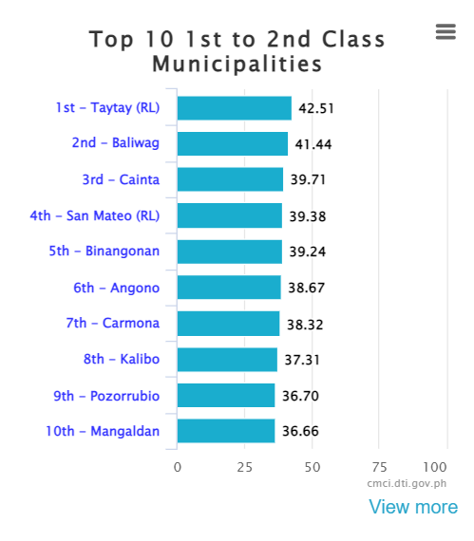
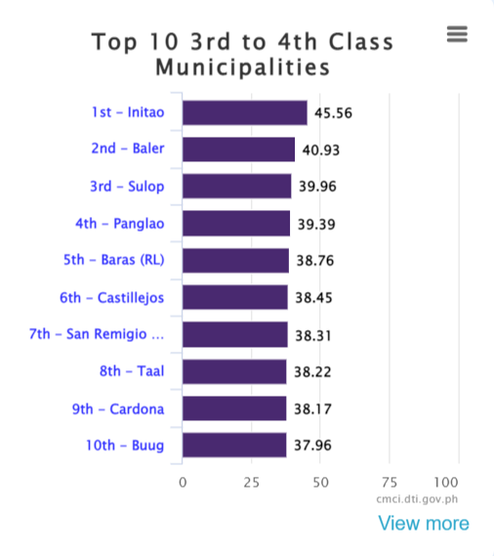
NATIONAL CMCI RANKINGS
Notes:
But these basic functions should also be seen in light of the LGU’s functions and relations with respect to each other.
Provincial governments, for example, are mandated to empower and supervise component cities and municipalities. The province, composed of cluster of municipalities, or municipalities and component cities, and as a political and corporate unit of government, serves as dynamic mechanism for developmental processes and effective governance of local government units within its territorial jurisdiction.
Cities and municipalities, on the other hand, fulfill the primary responsibilities of enforcing laws and ordinances, implementing local programs, and providing basic service delivery. The city and municipality, consisting of a group of barangays, serves primarily as a general purpose government for the coordination and delivery of basic, regular and direct services and effective governance of the inhabitants within its territorial jurisdiction.
Finally, they do this with the help of the barangay, which act as first responders to the needs of the community. As the basic political unit, the barangay serves as the primary planning and implementing unit of government policies, plans, programs, projects, and activities in the community, and as a forum wherein the collective views of the people may be expressed, crystallized and considered, and where disputes may be amicably settled.

Slide 13
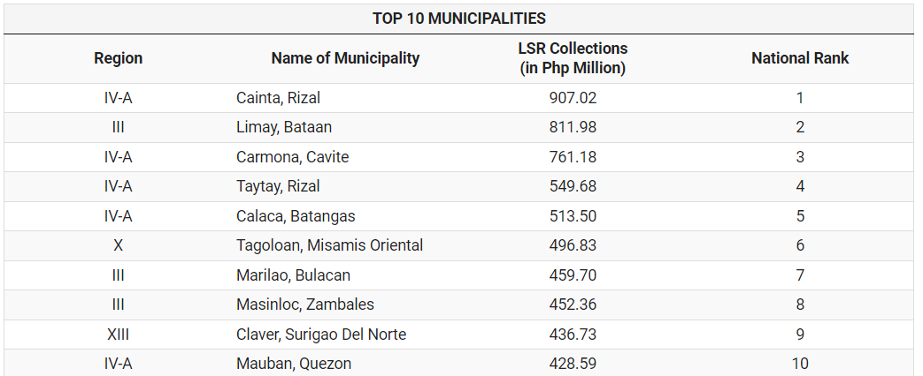
TOP MUNICIPALITIES IN TERMS OF LOCALLY SOURCED REVENUE (TOTAL COLLECTIONS PER BLGF DATA)
Notes:
But these basic functions should also be seen in light of the LGU’s functions and relations with respect to each other.
Provincial governments, for example, are mandated to empower and supervise component cities and municipalities. The province, composed of cluster of municipalities, or municipalities and component cities, and as a political and corporate unit of government, serves as dynamic mechanism for developmental processes and effective governance of local government units within its territorial jurisdiction.
Cities and municipalities, on the other hand, fulfill the primary responsibilities of enforcing laws and ordinances, implementing local programs, and providing basic service delivery. The city and municipality, consisting of a group of barangays, serves primarily as a general purpose government for the coordination and delivery of basic, regular and direct services and effective governance of the inhabitants within its territorial jurisdiction.
Finally, they do this with the help of the barangay, which act as first responders to the needs of the community. As the basic political unit, the barangay serves as the primary planning and implementing unit of government policies, plans, programs, projects, and activities in the community, and as a forum wherein the collective views of the people may be expressed, crystallized and considered, and where disputes may be amicably settled.

Slide 14
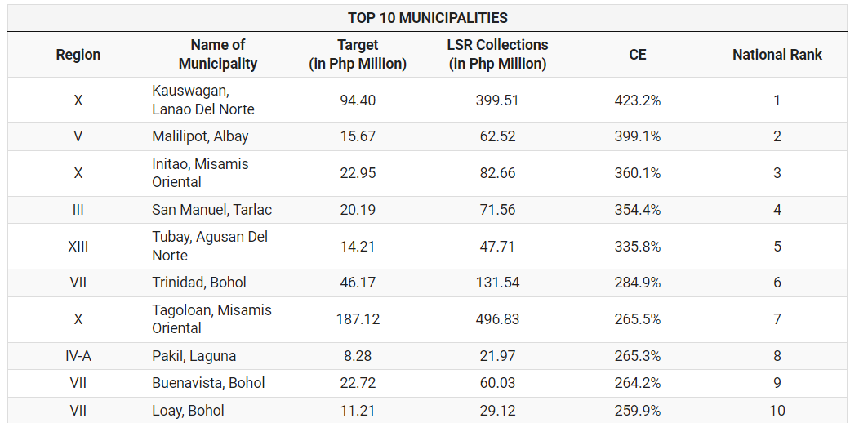
TOP MUNICIPALITIES IN TERMS OF COLLECTION EFFICIENCY OF LOCALLY SOURCED REVENUE
Notes:
But these basic functions should also be seen in light of the LGU’s functions and relations with respect to each other.
Provincial governments, for example, are mandated to empower and supervise component cities and municipalities. The province, composed of cluster of municipalities, or municipalities and component cities, and as a political and corporate unit of government, serves as dynamic mechanism for developmental processes and effective governance of local government units within its territorial jurisdiction.
Cities and municipalities, on the other hand, fulfill the primary responsibilities of enforcing laws and ordinances, implementing local programs, and providing basic service delivery. The city and municipality, consisting of a group of barangays, serves primarily as a general purpose government for the coordination and delivery of basic, regular and direct services and effective governance of the inhabitants within its territorial jurisdiction.
Finally, they do this with the help of the barangay, which act as first responders to the needs of the community. As the basic political unit, the barangay serves as the primary planning and implementing unit of government policies, plans, programs, projects, and activities in the community, and as a forum wherein the collective views of the people may be expressed, crystallized and considered, and where disputes may be amicably settled.

Slide 15

WHAT SHOULD WE STRIVE TO BE AS LOCAL FINANCIAL ADMINISTRATORS?
Notes:
But these basic functions should also be seen in light of the LGU’s functions and relations with respect to each other.
Provincial governments, for example, are mandated to empower and supervise component cities and municipalities. The province, composed of cluster of municipalities, or municipalities and component cities, and as a political and corporate unit of government, serves as dynamic mechanism for developmental processes and effective governance of local government units within its territorial jurisdiction.
Cities and municipalities, on the other hand, fulfill the primary responsibilities of enforcing laws and ordinances, implementing local programs, and providing basic service delivery. The city and municipality, consisting of a group of barangays, serves primarily as a general purpose government for the coordination and delivery of basic, regular and direct services and effective governance of the inhabitants within its territorial jurisdiction.
Finally, they do this with the help of the barangay, which act as first responders to the needs of the community. As the basic political unit, the barangay serves as the primary planning and implementing unit of government policies, plans, programs, projects, and activities in the community, and as a forum wherein the collective views of the people may be expressed, crystallized and considered, and where disputes may be amicably settled.

Slide 16
End of presentation.
Thank you!

